Slide 1
Rockbuster Informative Data
By Javi Ramirez

Slide 2
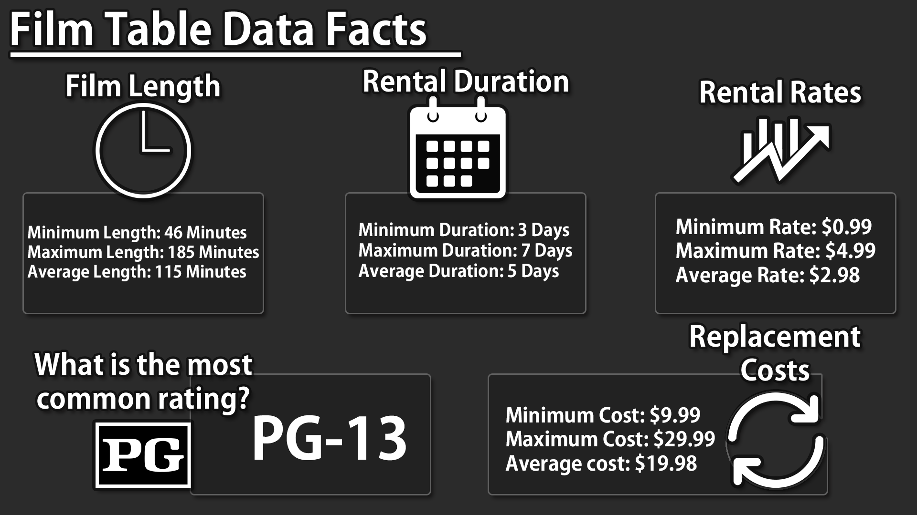

Slide 3
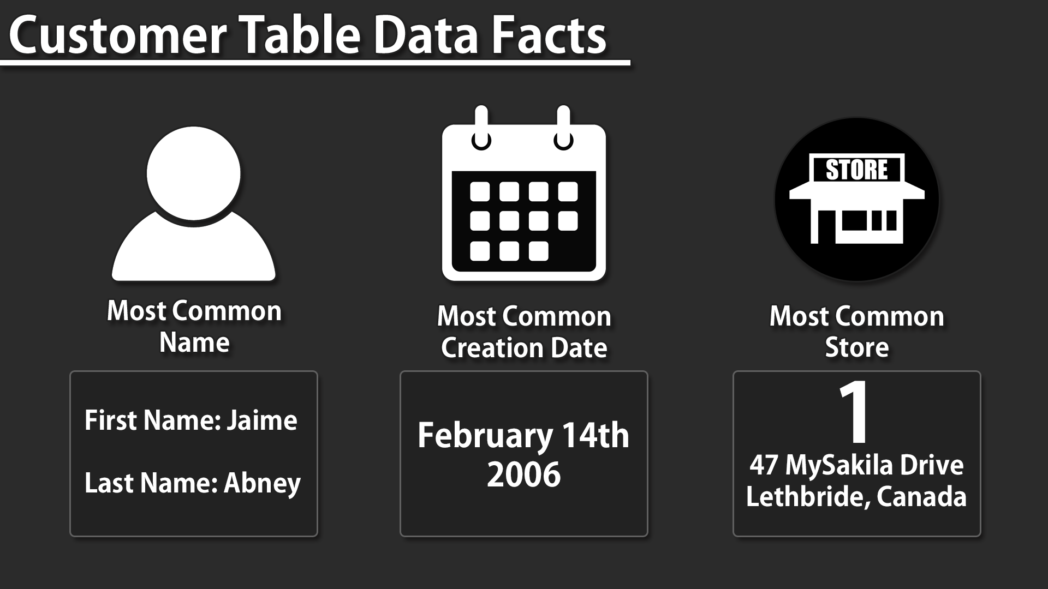

Slide 4
Notable findings
Most common film type is PG-13 films, going more in depth can give us an insight on how we can market our most common film type to get more rentals.
February had our most common date for customer creations, looking into events going on we can see about how we can capitalize on the events to acquire more signups.

Slide 5
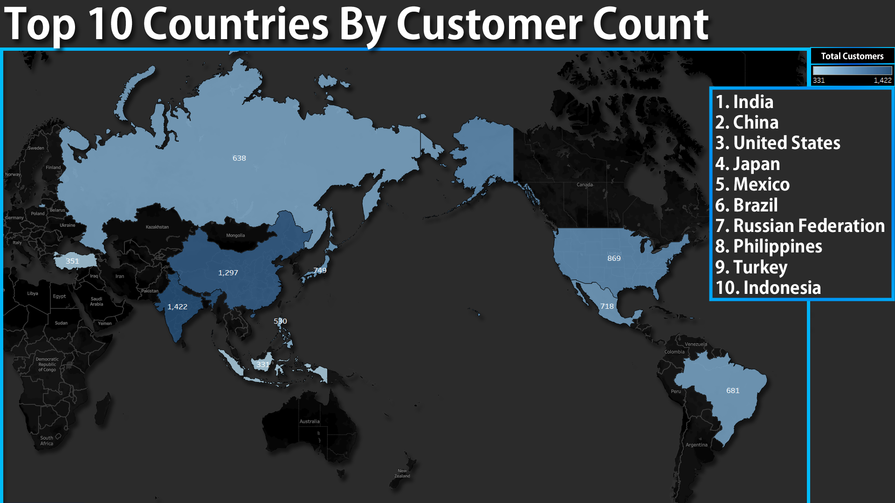

Slide 6
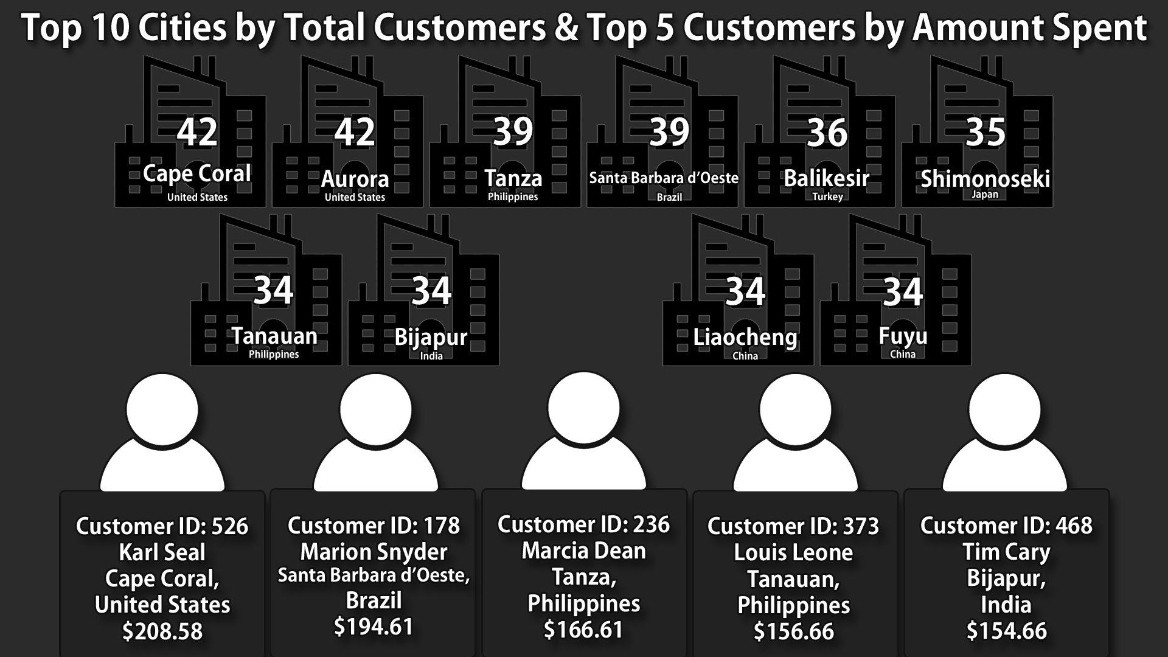

Slide 7
This chart shows the Top 10 Cities within the Top 10 Countries, then we looked for the Top 5 customers within those 10 Cities by amount spent.
With this information, we can provide rewards to our most dedicated members to keep loyalty, and if proven effective, we can look into loyalty programs to keep customers.

Slide 8
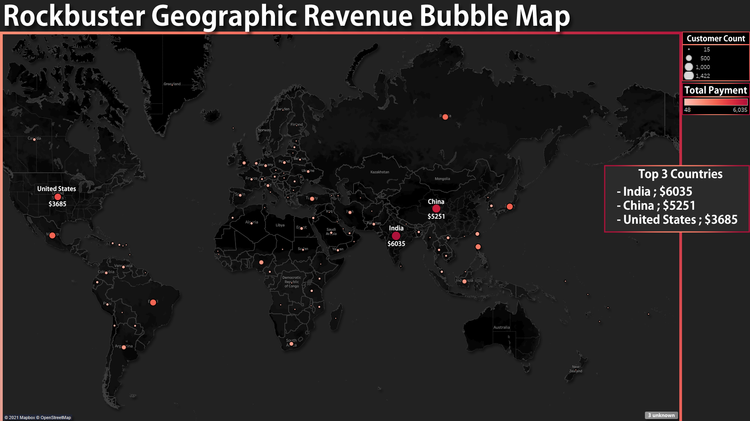

Slide 9
This chart shows us which areas have been the most profitable, it is represented by the darkness of the red. India, China, and the U.S have brought the most revenue.
The size of the bubble shows customer size, our overall customer base is low, and our size of the bubbles reflect on that, we should find solutions to gather more customers to expand business.
https://public.tableau.com/app/profile/javi.ramirez/viz/Top10CountriesbyTotalCustomerCount/MapChart
https://public.tableau.com/app/profile/javi.ramirez/viz/Exercise3_10RockbusterGeographicRevenue/BubbleMap

